Slide 1

Lending Club Case Study for Consumer Finance Company
ShivaPrasad GARLAPATI Shrisha Bhat H

Slide 2
Problem Statement:
A finance company specializing in providing various types of loans to urban customers needs to make informed decisions on loan applications based on the applicants' profiles. The goal is to identify patterns in the loan applicants' data to pinpoint risky customers and minimize credit losses. By conducting thorough data cleaning, exploratory data analysis (EDA), and multivariate analysis, we aim to uncover patterns and relationships that indicate potential default risks.

Slide 3
Goals of Data Analysis:
Lending Club, a consumer finance marketplace with a broad range of loan offerings, faces a critical challenge in its loan approval process: minimizing financial losses from risky borrowers. These losses, known as credit losses, arise when borrowers default on their loans or have their loans charged off.
The primary goal of this analysis is to help Lending Club mitigate credit losses by addressing two key scenarios:
Identifying Reliable Borrowers: Recognize applicants who are likely to repay their loans to ensure profitability through interest payments and avoid missing valuable business opportunities.
Avoiding Risky Loans: Prevent approving loans for high-risk applicants who are likely to default, thus safeguarding the company from significant financial losses

Slide 4
Steps for Analysis:
Load Data: Import the CSV file into a Data Frame to begin processing.
Clean Data: Remove irrelevant columns to streamline the dataset and focus on key variables.
Address Data Issues: Resolve any problems in the required columns, including handling missing values, correcting data types, and fixing inconsistencies.
Analyze Distribution: Assess the distribution of key variables to gain insights into the data and ensure its readiness for analysis.
Create Risk Flag: Add a derived column to identify risky customers based on predefined criteria.
Apply Risk Criteria: Update the risk flag column based on established rules to classify customers as risky or non-risky.

Slide 5
Results

Slide 6
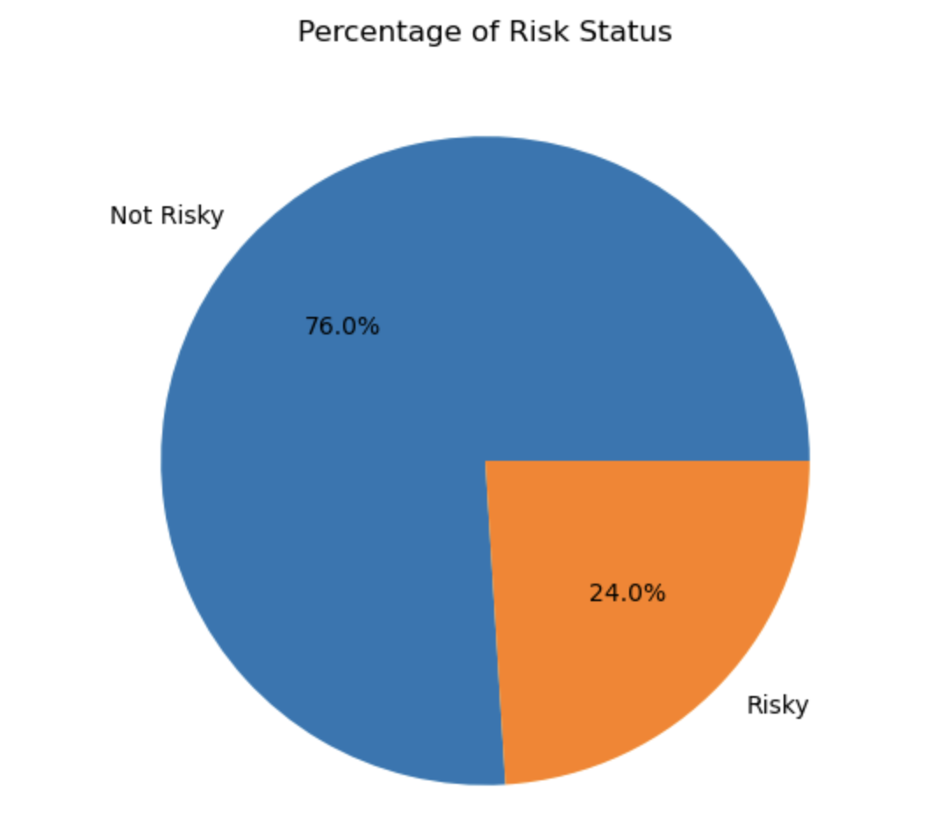
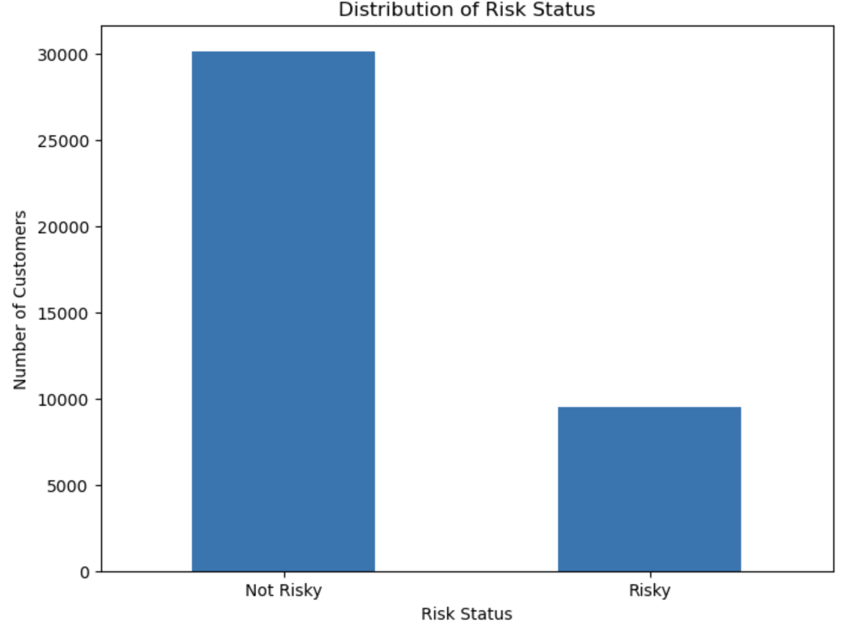
Results
Risk Classification: Out of 39,717 customers, 9,536 are classified as risky, which is 24% of the total.
Implication: Approving loans for these risky customers poses a significant financial risk.

Slide 7
Analysis

Slide 8
Observation: CA, NY and Florida are top 3 states with the number of loans provided.
50% of the states are not contributing to the lending process, opportunity is there to grow the business and earn more revenue.

Slide 9
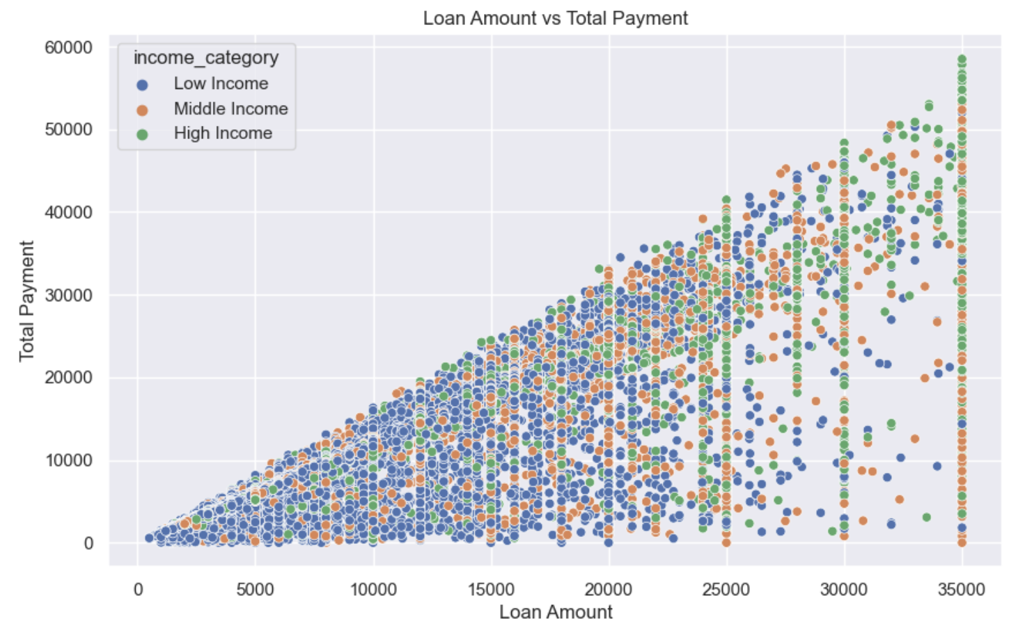
Observation: Customers with high income ranges are tend to pay higher loan amounts

Slide 10
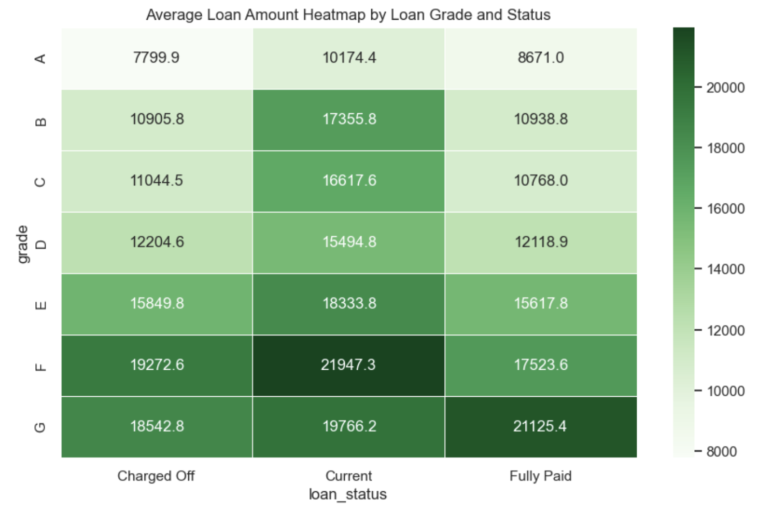
Observation: Average loan amounts are increasing from Grade A to Grade G

Slide 11
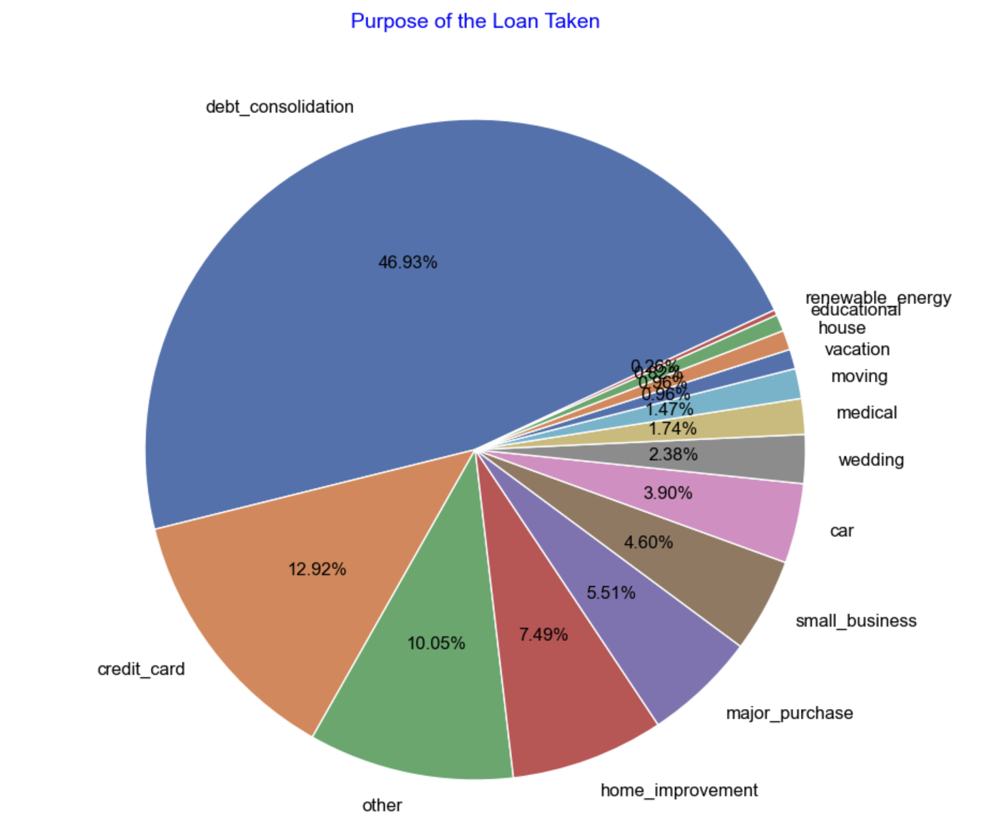
Observation: Around 47% of the loans taken for Debt Consolidation

Slide 12
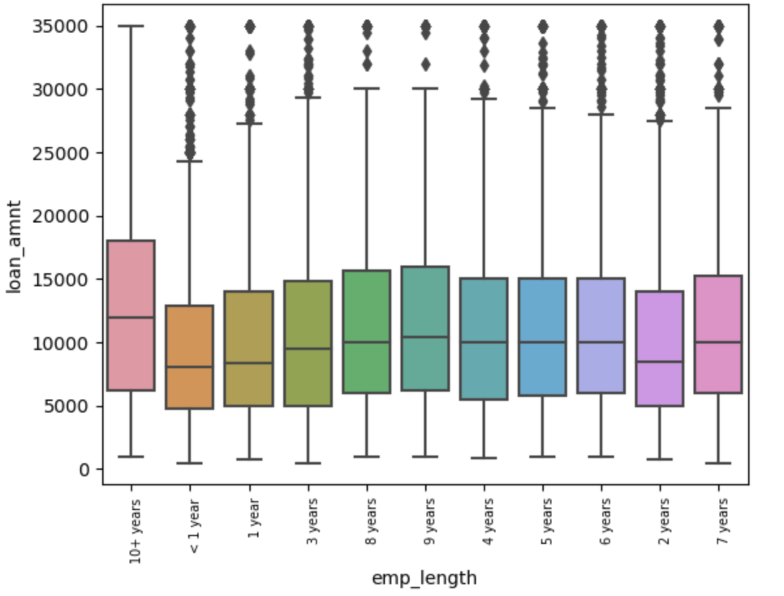
Observation: Employees with longer tenures are approved for higher loan amounts.

Slide 13
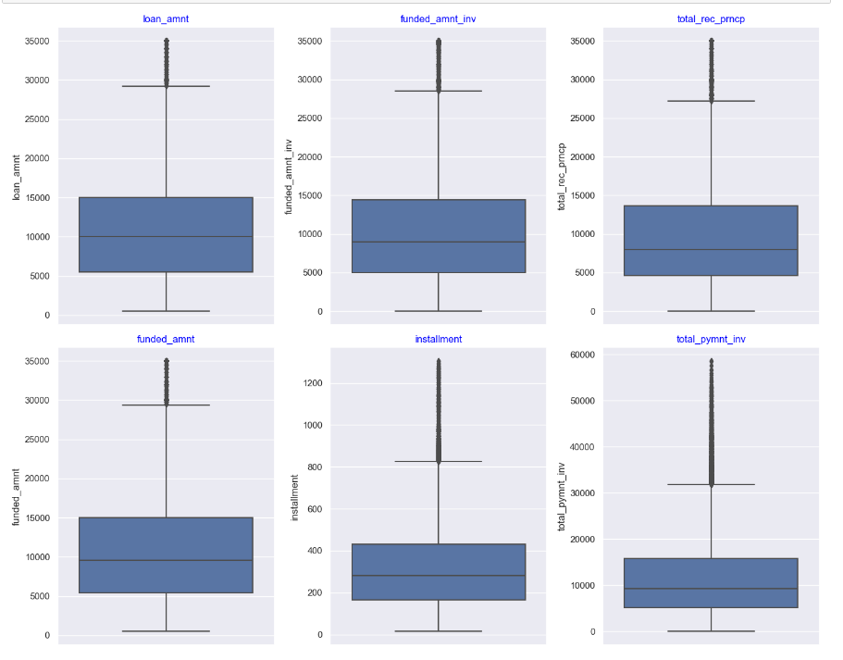
Data distribution by variables

Slide 14
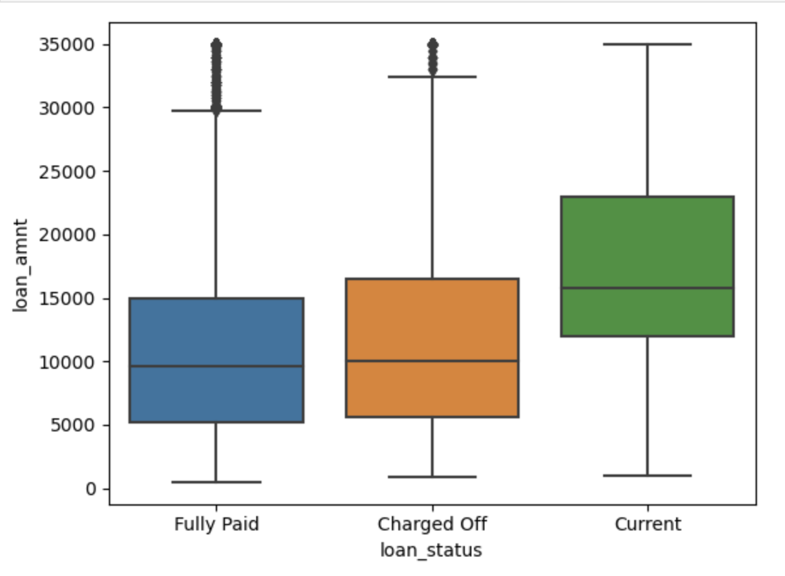
Observation: Median for the current paying loans is higher than charge off and full paid loans

Slide 15
Exploratory Data Analysis (EDA)- Multivariate Analysis
Correlation Insights:
Interest Rates, Recoveries, and Collection Recovery Fees: These factors show a positive correlation with loan default risk, indicating that higher values in these areas are associated with increased risk.
Funded Amount and Installments: Larger funded amounts and higher installment payments are also linked to a greater likelihood of default.
Comparison with Earlier Findings:
Employee Tenure and Loan Amount: Employees with longer tenures were approved for higher loan amounts. This suggests that loan approval amounts are influenced by tenure, but does not directly address default risk.
Loan Payment Trends: Customers with high income ranges are tend to pay higher loan amounts

Slide 16
Recommendations:
Based on our findings, we recommend that Lending Club:
Refine Loan Approval Criteria: Place increased emphasis on interest rates and loan purposes to enhance the precision of approval decisions.
Enhance Screening for Debt Consolidation Loans: Implement additional scrutiny for applicants seeking debt consolidation to better assess their risk profile.
Adopt Advanced Risk Assessment Models: Utilize more sophisticated models that capture the complex factors contributing to loan defaults for a more accurate risk evaluation.

Slide 17
Conclusion
Based on our analysis, out of 39,717 customers, 9,536 are classified as risky, which is 24% of the total. Approving loans for these risky customers poses a significant financial risk.
Observations: Higher income ranges are tend to pay higher loan amounts and employees with more tenure are trending to get higher loan amounts.
50% of the states are not contributing to the lending process, opportunity is there to grow the business and earn more revenue.

Slide 18
Acknowledgments
We extend our gratitude to the IIITB and UPGRAD communities for their valuable resources and insightful discussions, which have greatly enhanced this analysis.

